Slide 1
Digital Portfolio
STUDENT NAME: SUDHARSAN C S
REGISTER NO AND NMID: 2428C0522 &
4C8CD7F5C8D958883284A6A08EAE5F8C
DEPARTMENT: B.Sc - AIML
COLLEGE: KPR COLLEGE/ BHARATHIYAR UNIVERSITY

Slide 2
PROJECT TITLE
Sports Person’s Portfolio Website.

Slide 3


AGENDA
Problem Statement
Project Overview
End Users
Tools and Technologies
Portfolio design and Layout
Features and Functionality
Results and Screenshots
Conclusion
Github Link
3/21/2024 Annual Review

Slide 4

PROBLEM STATEMENT
Many athletes and sports professionals lack a dedicated platform to showcase their skills, achievements, and career highlights in a structured and visually engaging way. Relying on a basic resume or scattered social media profiles often fails to capture their performance statistics, milestones, and growth as a player. In today’s highly competitive sports industry, a well-designed digital portfolio can serve as a powerful tool to present an athlete’s journey, attract sponsorships, connect with coaches, and create new career opportunities.

Slide 5

PROJECT OVERVIEW
Centralized Repository – Collect and maintain all publications (journals, conferences, books, patents) in one platform. Enhanced Visibility – Improve academic reach, global discoverability, and citation impact. Authenticity & Integration – Link with DOI, ORCID, Scopus, PubMed, Google Scholar for validation and credibility. Research Networking – Enable collaborations by showcasing expertise and research interests.

Slide 6

WHO ARE THE END USERS?
Athletes showcasing their career highlights and performance stats Coaches evaluating players’ skills and progress Sports Teams & Clubs scouting for potential talent Sponsors & Agents looking for promising sports professionals to support Event Organizers reviewing athlete profiles for participation or selection

Slide 7

TOOLS AND TECHNIQUES
HTML CSS JavaScript Git and GitHub VS Code

Slide 8
POTFOLIO DESIGN AND LAYOUT
Home / About Athlete – Quick intro, background, and sports journey Career Highlights – Major achievements, tournaments, medals, and awards Skills & Stats – Core skills, positions, personal bests, and performance data Gallery / Media – Photos, videos, and match highlights Contact & Connect – Ways for coaches, teams, and sponsors to reach out Responsive Layout – Optimized for mobile, tablet, and desktop viewing
8

Slide 9
FEATURES AND FUNCTIONALITY
Easy navigation bar for all sections. Career highlights with photos and stats. Interactive performance charts or videos. Contact form for teams, coaches, or sponsors. Fully responsive on all devices.

Slide 10
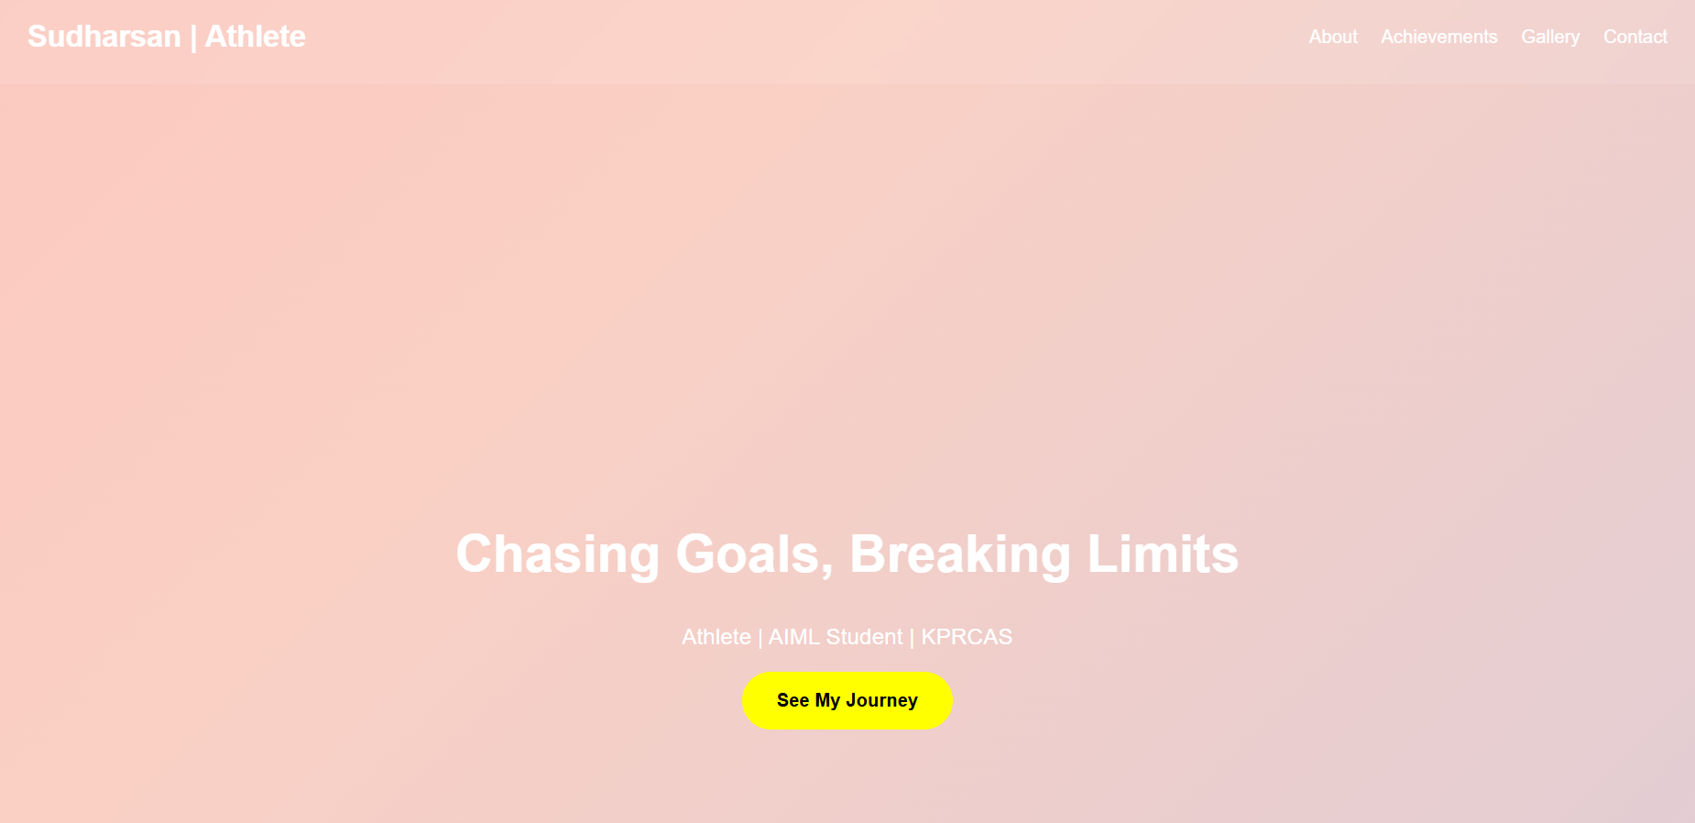

RESULTS AND SCREENSHOTS
3/21/2024 Annual Review
10

Slide 11
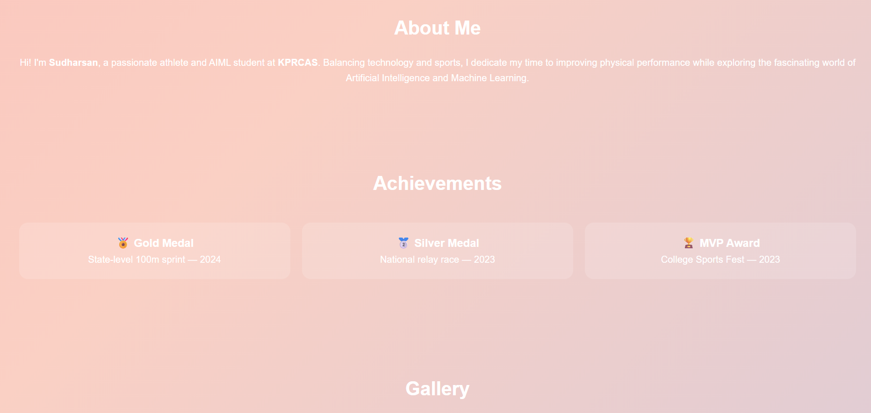
RESULTS AND SCREENSHOTS
3/21/2024 Annual Review
11

Slide 12
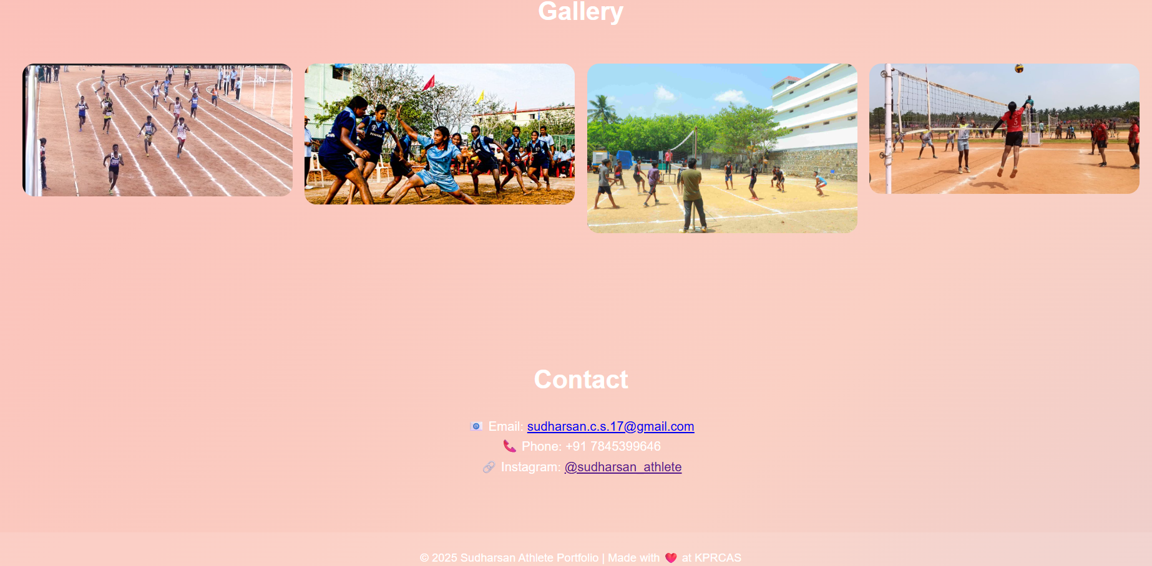
RESULTS AND SCREENSHOTS
3/21/2024 Annual Review
12

Slide 13
GITHUB LINK
https://github.com/sudharsancs17

Slide 14
CONCLUSION
Highlights my sports skills and career achievements Summarizes my journey, milestones, and dedication to the game Helps coaches, teams, and sponsors understand my potential Makes it easier for scouts, managers, and supporters to connect with me
14

